Slide 1
Team Under Cover
Amazon Ratings predictions based on book cover image

Slide 2
Can you judge a book by its cover?
Graphic designers are hired to design books that are as visually pleasing and likely to sell as possible,
but what makes a good book cover?

Slide 3
How Might we solve this problem with machine learning?
Look at lot of images
Infer data or characteristics about these images
Associate image data with ratings
Create Models for “Good” and “Bad” images
Train Model with Image Data
Make Ratings Predictions with Analyzed Sample Images
Easy, right?

Slide 4
Look at lot of images
Metadata for 9.4 million Products
ASIN and Book Cover image url
Data provided by: R. He, J. McAuley. Modeling the visual evolution of fashion trends with one-class collaborative filtering. WWW, 2016 J. McAuley, C. Targett, J. Shi, A. van den Hengel. Image-based recommendations on styles and substitutes. SIGIR, 2015

Slide 5
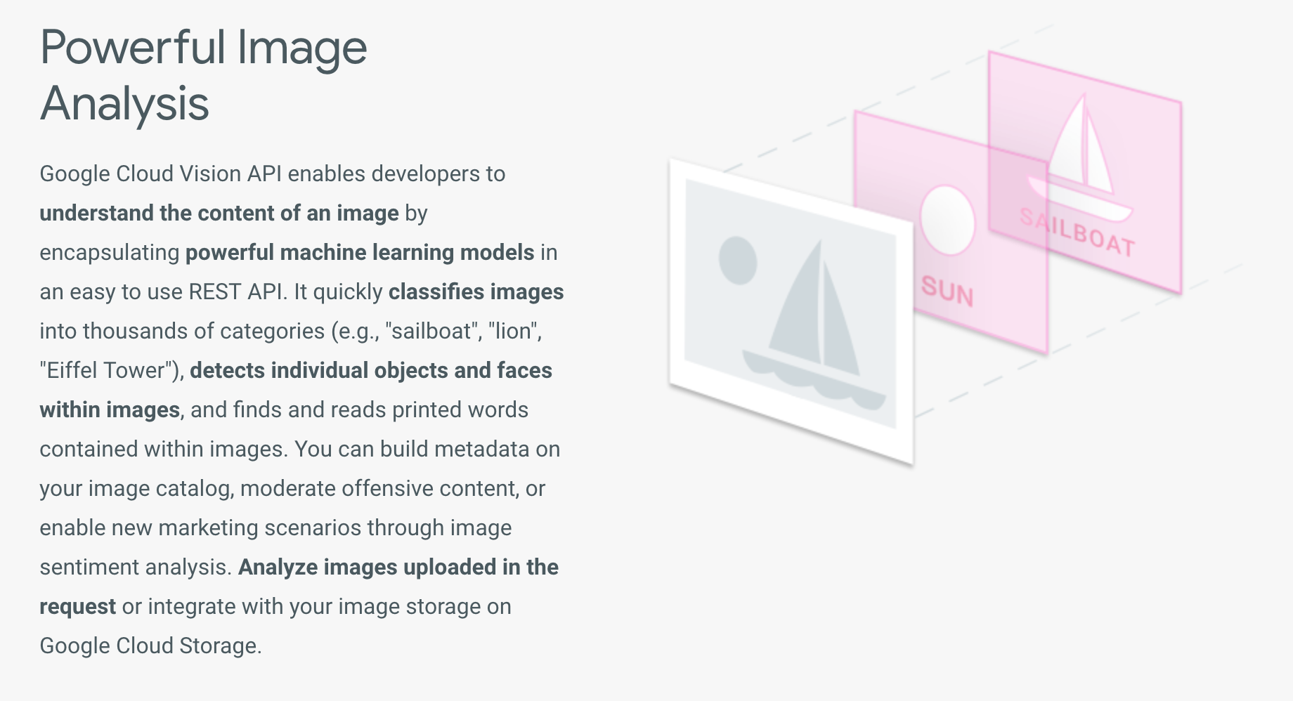
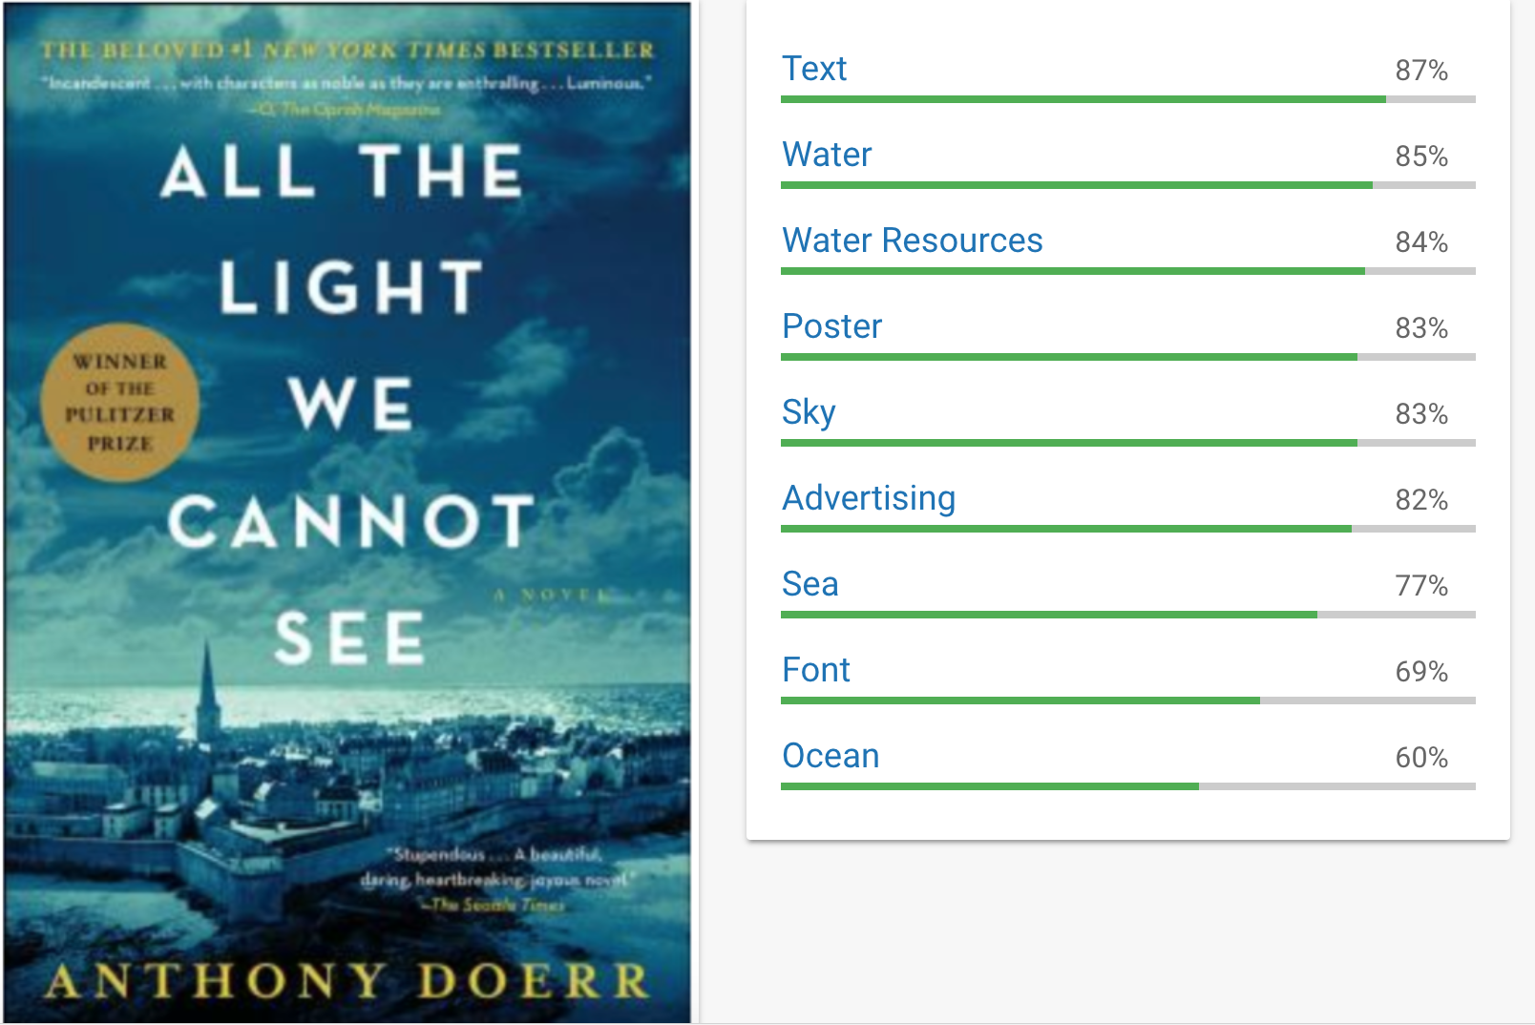
Infer data or characteristics
about these images
Data provided by: R. He, J. McAuley. Modeling the visual evolution of fashion trends with one-class collaborative filtering. WWW, 2016 J. McAuley, C. Targett, J. Shi, A. van den Hengel. Image-based recommendations on styles and substitutes. SIGIR, 2015

Slide 6
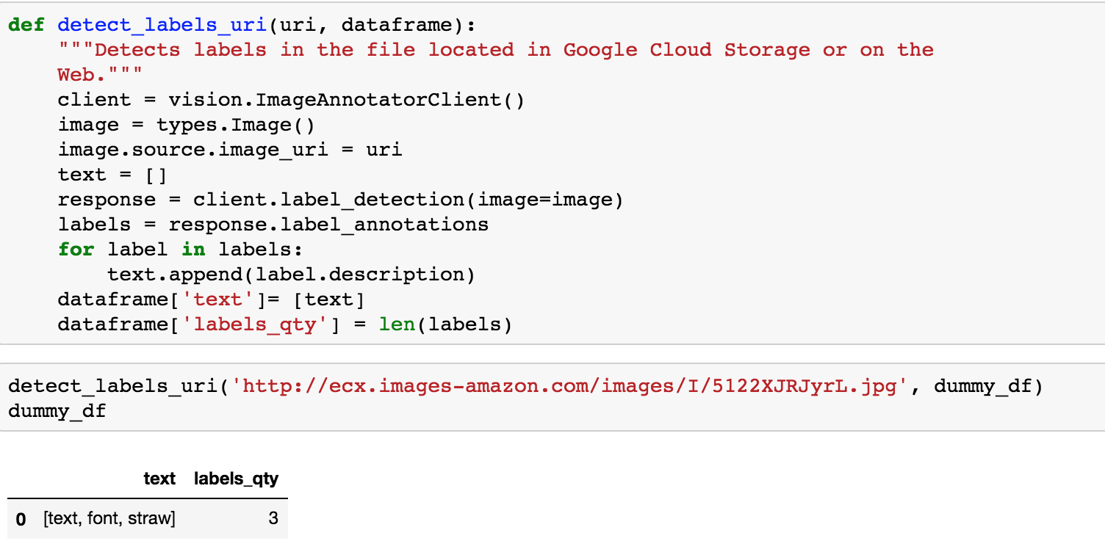
Infer data or characteristics about these images
Google Cloud has an embedded
Image recognition service!
Data provided by: R. He, J. McAuley. Modeling the visual evolution of fashion trends with one-class collaborative filtering. WWW, 2016 J. McAuley, C. Targett, J. Shi, A. van den Hengel. Image-based recommendations on styles and substitutes. SIGIR, 2015

Slide 7
Create Models for
“Good” and “Bad” images
Bad Reviews < 2.0
Good Reviews > 4.0
Data provided by: R. He, J. McAuley. Modeling the visual evolution of fashion trends with one-class collaborative filtering. WWW, 2016 J. McAuley, C. Targett, J. Shi, A. van den Hengel. Image-based recommendations on styles and substitutes. SIGIR, 2015

Slide 8
Associate image data with ratings
142.8 Million Reviews
Average Review by ASIN for Books since 2014
Data provided by: R. He, J. McAuley. Modeling the visual evolution of fashion trends with one-class collaborative filtering. WWW, 2016 J. McAuley, C. Targett, J. Shi, A. van den Hengel. Image-based recommendations on styles and substitutes. SIGIR, 2015

Slide 9
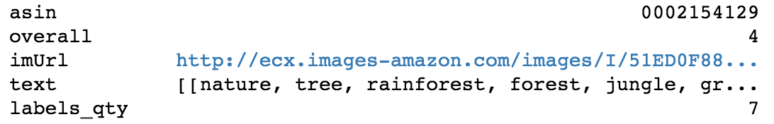
Associate image data with ratings
Data provided by: R. He, J. McAuley. Modeling the visual evolution of fashion trends with one-class collaborative filtering. WWW, 2016 J. McAuley, C. Targett, J. Shi, A. van den Hengel. Image-based recommendations on styles and substitutes. SIGIR, 2015

Slide 10
Associate image data with ratings
How do you convert words to insight?
?
WORD TOKENIZATION!
Data provided by: R. He, J. McAuley. Modeling the visual evolution of fashion trends with one-class collaborative filtering. WWW, 2016 J. McAuley, C. Targett, J. Shi, A. van den Hengel. Image-based recommendations on styles and substitutes. SIGIR, 2015

Slide 11
Associate image data with ratings
Tokenization turns words into numbers,
then is able to process them through
machine learning models
Data provided by: R. He, J. McAuley. Modeling the visual evolution of fashion trends with one-class collaborative filtering. WWW, 2016 J. McAuley, C. Targett, J. Shi, A. van den Hengel. Image-based recommendations on styles and substitutes. SIGIR, 2015

Slide 12
Train Model with Image Data
word
unique token
Token count
weighting by number of words per cover
How do you convert words to insight?
Data provided by: R. He, J. McAuley. Modeling the visual evolution of fashion trends with one-class collaborative filtering. WWW, 2016 J. McAuley, C. Targett, J. Shi, A. van den Hengel. Image-based recommendations on styles and substitutes. SIGIR, 2015

Slide 13
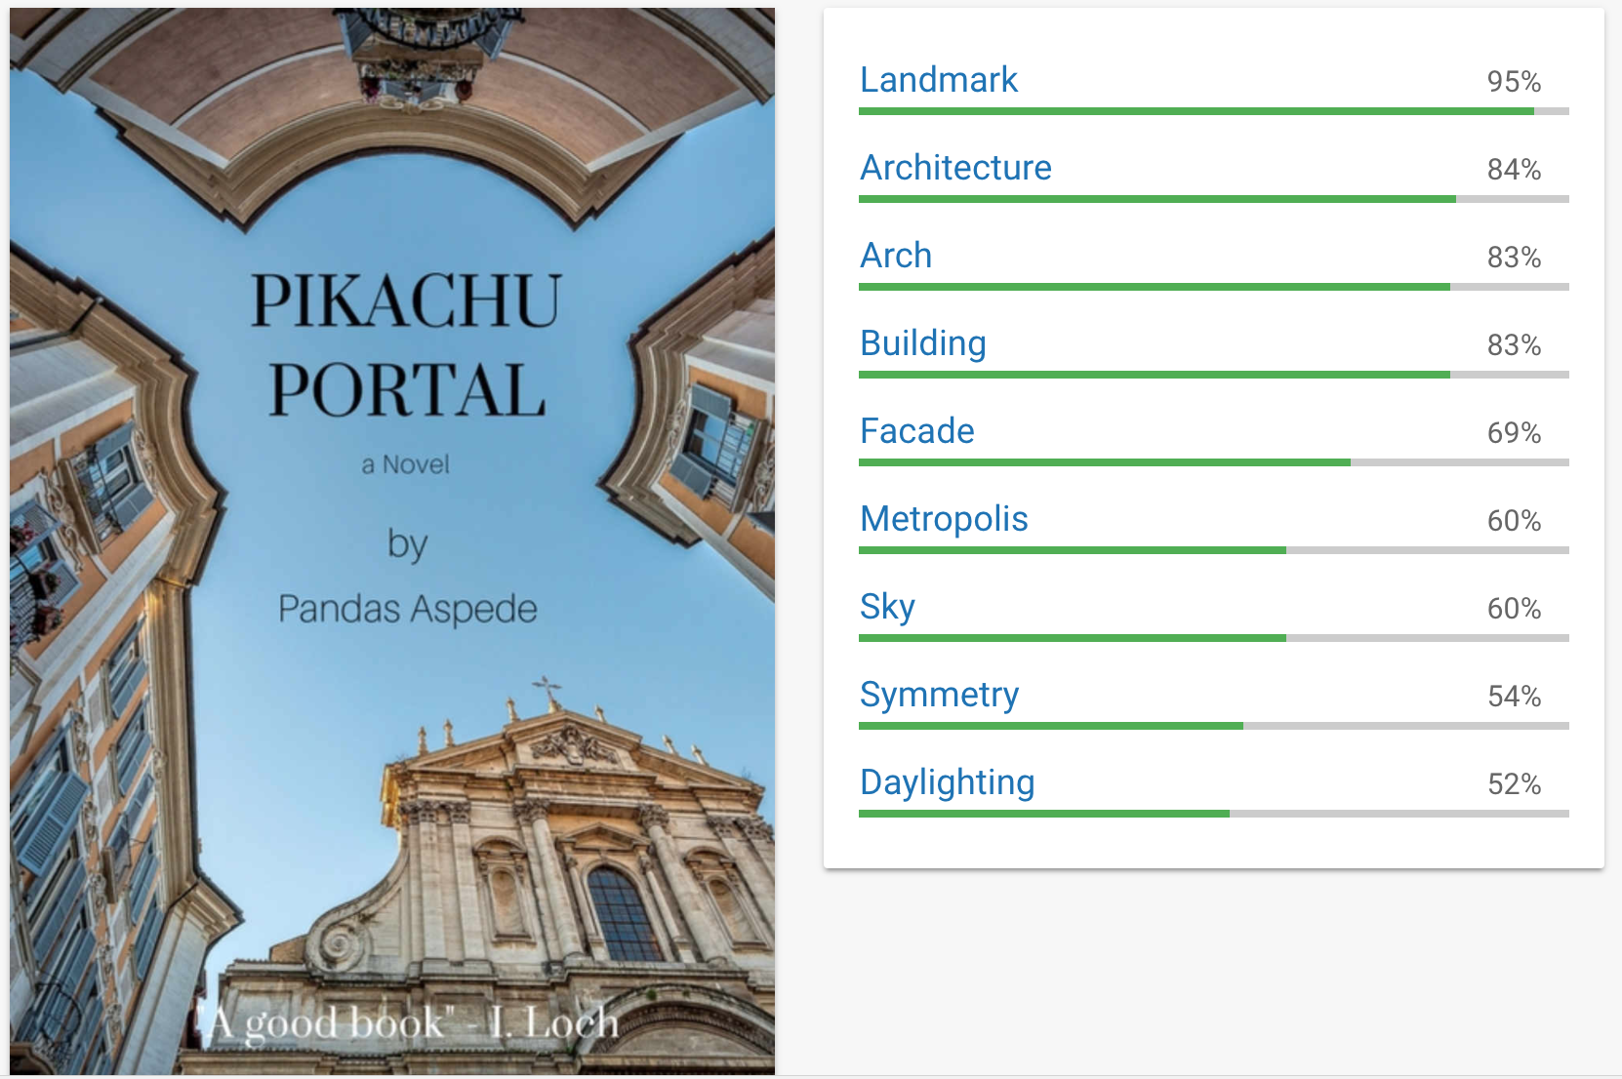
Make Ratings Predictions with Analyzed Sample Images
We can now use Google Vision API to get book cover characteristics and our models to determine whether a cover is most likely to clustered with the “Good” or “Bad” Covers
Data provided by: R. He, J. McAuley. Modeling the visual evolution of fashion trends with one-class collaborative filtering. WWW, 2016 J. McAuley, C. Targett, J. Shi, A. van den Hengel. Image-based recommendations on styles and substitutes. SIGIR, 2015

Slide 14
What did we learn?
Data Scientists are Plumbers
Connecting all of the pipes was the most difficult aspect
Big Data is hard to work with and APIs can be expensive
We had a hard time manipulating the large datasets and ultimately, had to use a smaller subset of data
While Google offers a credit, it charges for more than 1,000 API requests per month
Image Recognition Varies Widely
Google, Microsoft, and other providers analyze images differently. It was difficult to get the type of data we wanted
Text isn’t as easy to work with as you’d think
Beyond NLP, text has to be transformed for machine learning models, which took time

